Slide 1

Building & Mining Knowledge Graphs
KEN4256
Lecture 1: Introduction to Knowledge Graphs
2024

Slide 2
© 2024 by Michel Dumontier and the Institute of Data Science at Maastricht University is licensed under Attribution 4.0 International
To view a copy of this license, visit http://creativecommons.org/licenses/by/4.0/
This license requires that reusers give credit to the creator. It allows reusers to distribute, remix, adapt, and build upon the material in any medium or format, even for commercial purposes.
id: KEN4256_L1
version: 1.2024.0
created: January 8, 2019
last modified: March 26, 2024
published on: March 26, 2024

Slide 3
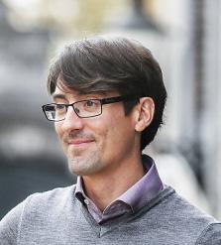



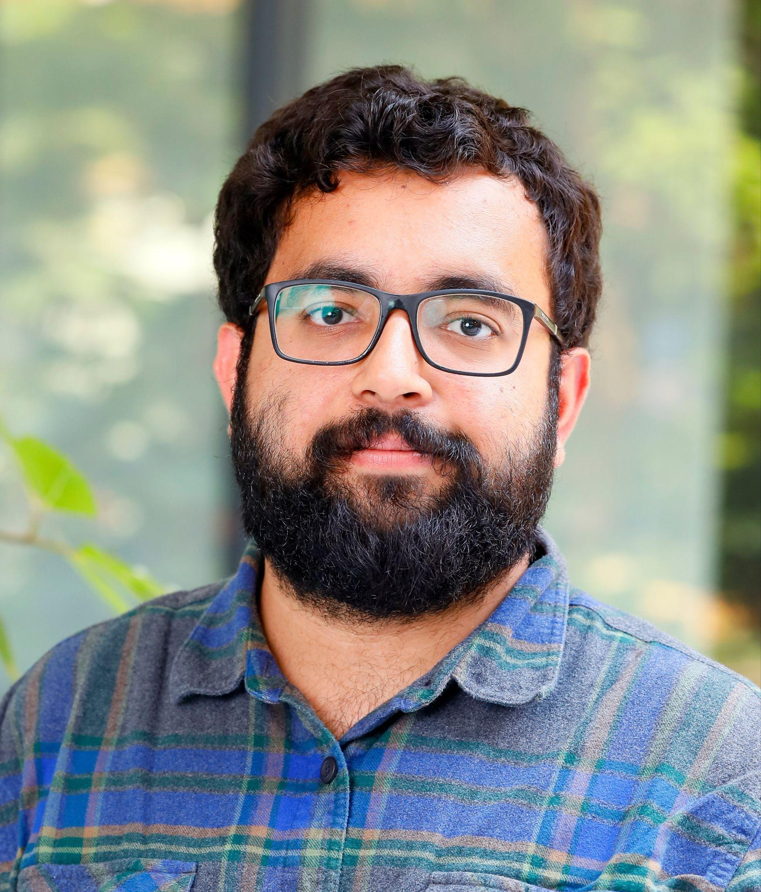
Course Instructors
Dr. Michel Dumontier
Distinguished Professor
Institute of Data Science
Expertise: knowledge graphs, ontologies, linked data, machine learning, deep learning, personalised medicine
michel.dumontier@maastrichtuniversity.nl
Vincent Emonet
Data Science Developer
Institute of Data Science
Expertise: semantic web, ontology + repositories, data integration, devops
vincent.emonet@maastrichtuniversity.nl
Dr. Rena Yang
Postdoctoral Fellow
Institute of Data Science
Expertise: machine learning, statistical modeling
rena.yang@maastrichtuniversity.nl
Shervin Mehryar
PhD Student
Institute of Data Science
Expertise: knowledge graphs, semantic web, deep learning, optimization, neuro-symbolic agents
shervin.mehryar@maastrichtuniversity.nl
Rishabh Jakhar
PhD Student
Institute of Data Science
Expertise: deep learning, image processing, numerical optimization
rishabh.jakhar@maastrichtuniversity.nl

Slide 4
Lecture outline
The ‘What’ and ‘Why’ of knowledge graphs
Knowledge graph representations
Course logistics
Use of AI

Slide 5
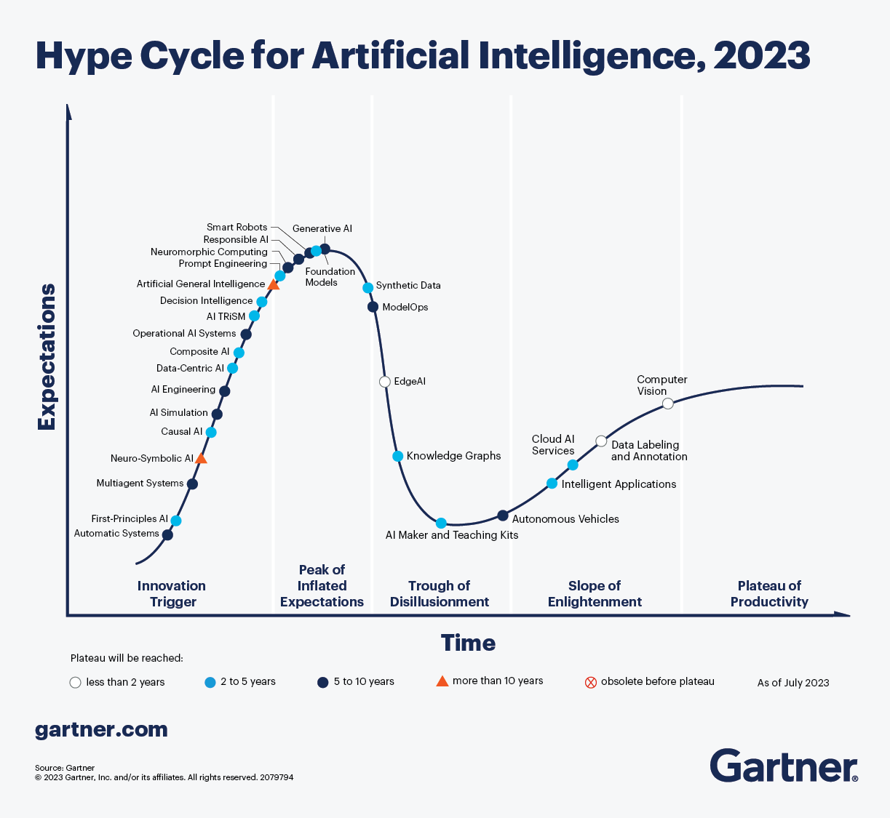
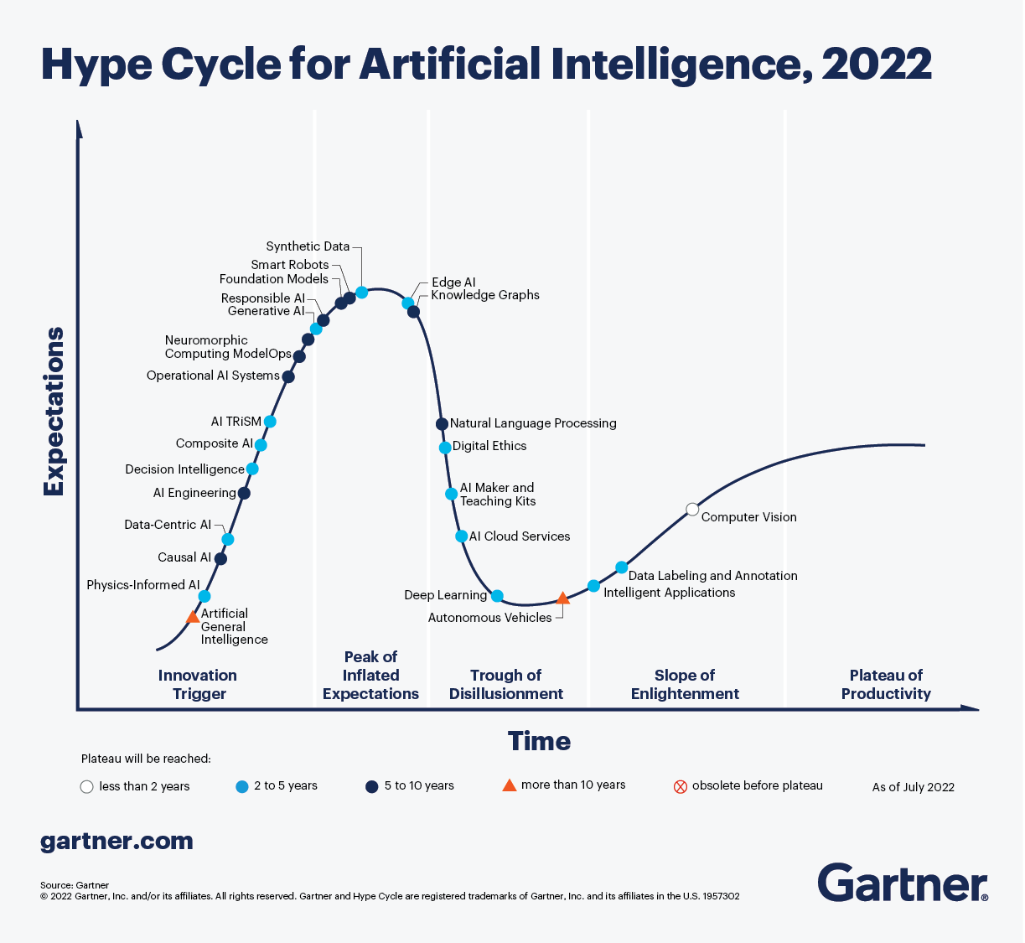
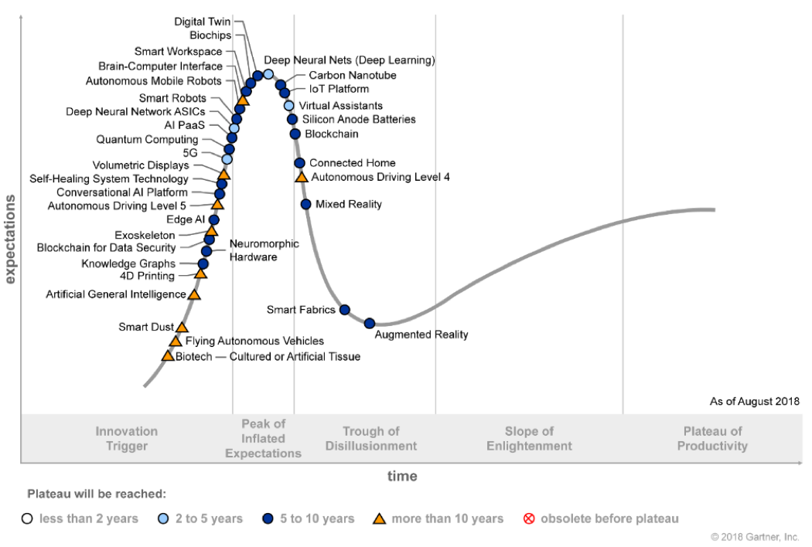

Slide 6
History around the term knowledge graph
1974, Marchi and Miguel defined a knowledge graph as a mathematical structure with vertices as knowledge units connected by edges that represent the prerequisite relation.
In 2007, DBpedia and Freebase were created as graph based knowledge repositories (but did not use the term).
In 2012, Google introduces the “Knowledge graph” …
E. Marchi and O. Miguel, 1974. “On the Structure of the Teaching-learning Interactive Process,” International Journal of Game Theory, 3(2):83–99.

Slide 7
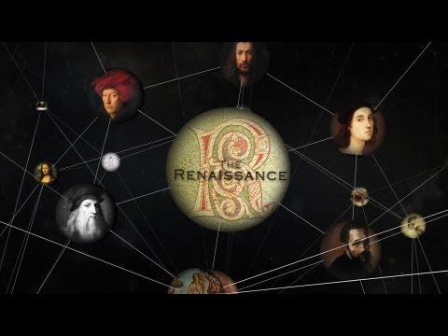
https://www.youtube.com/watch?v=mmQl6VGvX-c
Notes:
https://www.youtube.com/watch?v=mmQl6VGvX-c

Slide 8
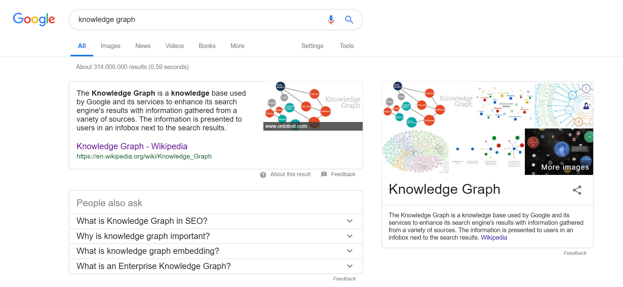
Notes:
A knowledge graph is a special kind of database which stores knowledge in a machine-readable form and provides a means for information to be collected, organised, shared, searched and utilised.

Slide 9
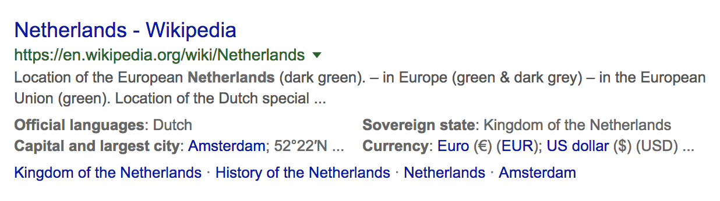
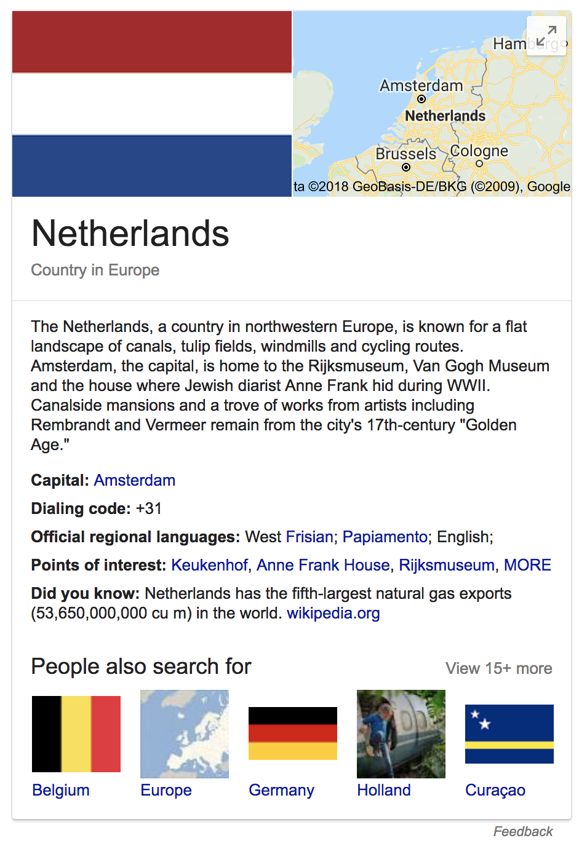
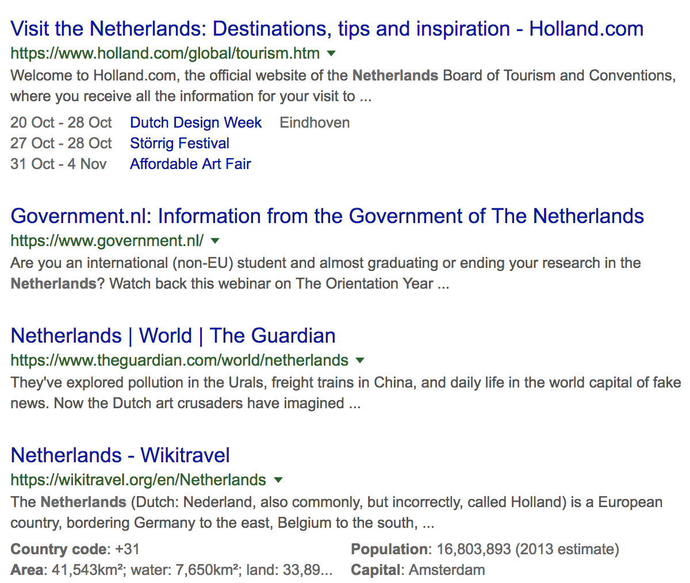
powered by schema.org
Notes:
So, search results are no longer just lists of snippets pointing to pages that are ordered by information retrieval scores and PageRank.

Slide 10
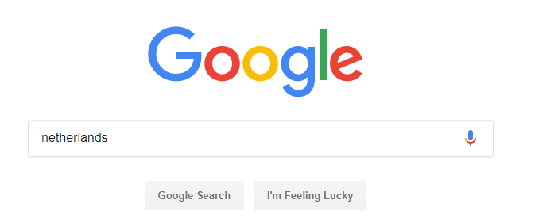
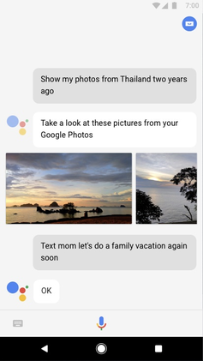
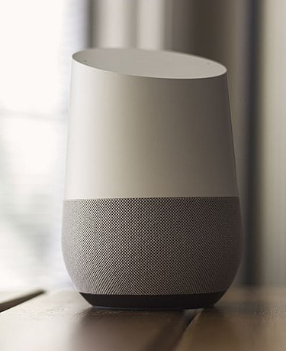
Google Knowledge Graph Applications
Google Search
Google Voice Assistant
Google Home Services

Slide 11
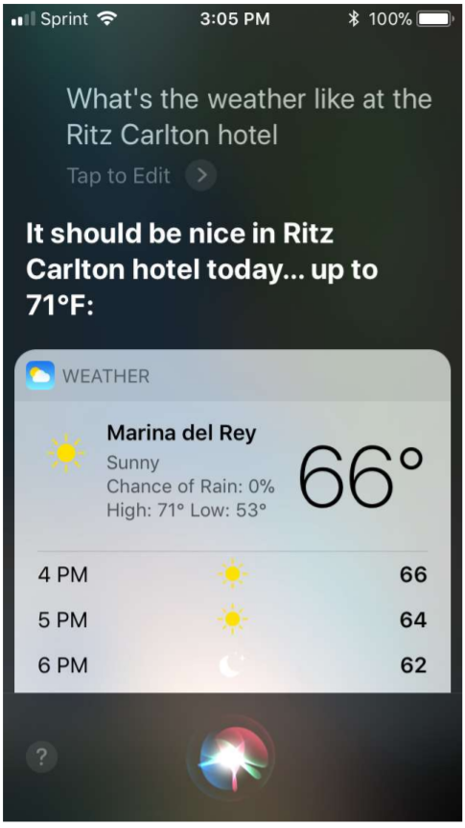
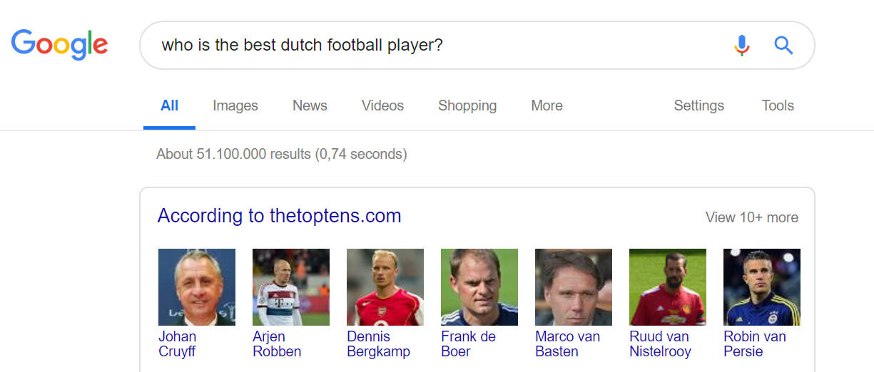
Personal Assistants
Source: kgtutorial.github.io

Slide 12

Semantic Question answering
IBM Research undertook a challenge to build a computer system that could compete at the human champion level in real time on the American TV quiz show, Jeopardy
Led to building of the DeepQA architecture and the implementation of Watson
DeepQA leverages semistructured and structured content, which include databases, taxonomies, and ontologies, such as DBpedia, WordNet and the Yago ontology
http://www.aaai.org/Magazine/Watson/watson.php

Slide 13
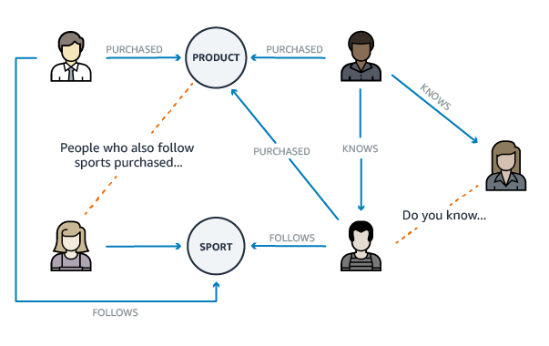
Recommendation Systems
Source: https://geomarketing.com

Slide 14
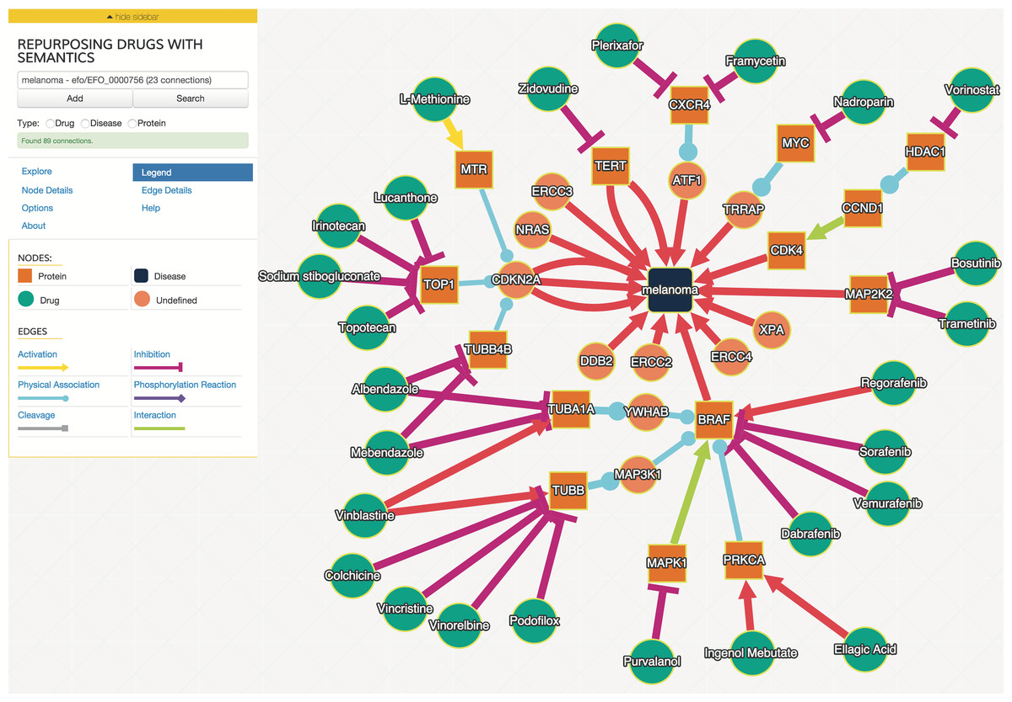
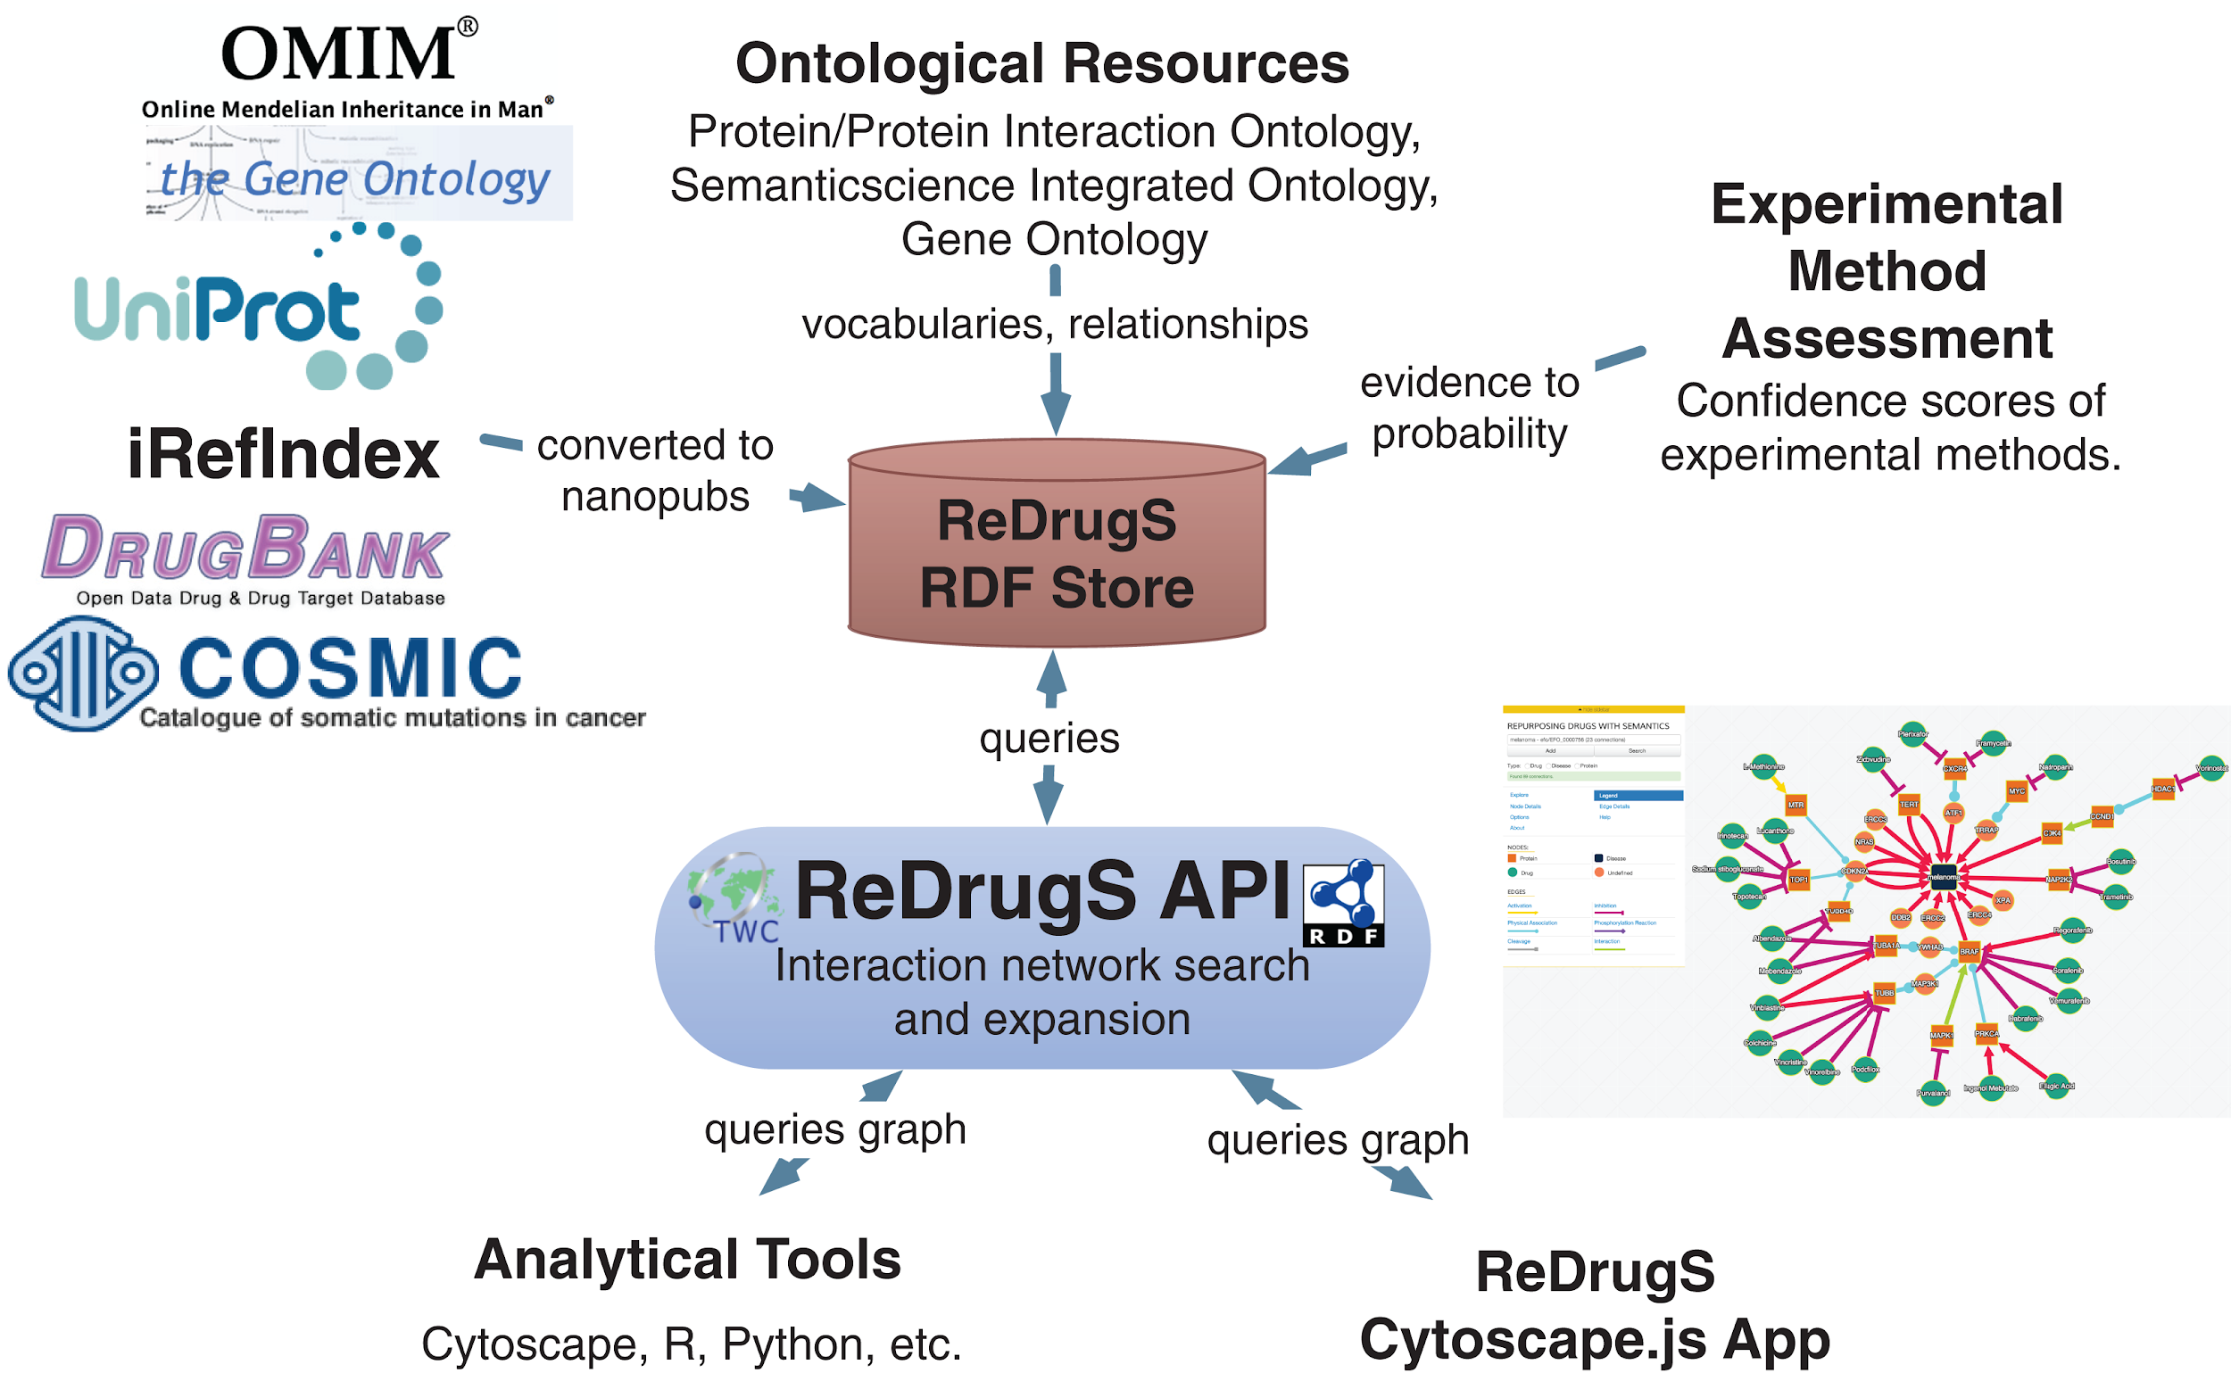
Discovery science

Slide 15


What interests you about KGs?
ⓘ
Click Present with Slido or install our Chrome extension to activate this poll while presenting.
Notes:
📣 This is Slido interaction slide, please don't delete it. ✅ Click on 'Present with Slido' and the poll will launch automatically when you get to this slide.

Slide 16
knowledge graph terminology

Slide 17
Graph (or Network)
A graph G is composed of two parts (V,E) where V is a set of nodes (vertices) and E is a set of edges (arcs, lines).
An edge is a pair (x,y), where x and y belong to V.
An undirected graph is a graph in which edges do not have direction. The nodes are unordered pairs in the definition of every edge.
A directed graph is a graph in which an edge has a direction. The nodes are ordered pairs in the definition of every edge.
undirected edge
node
(vertex)
node
(vertex)
directed edge
node
(vertex)
node
(vertex)

Slide 18
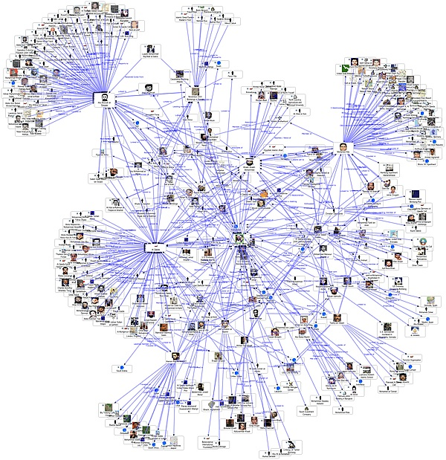
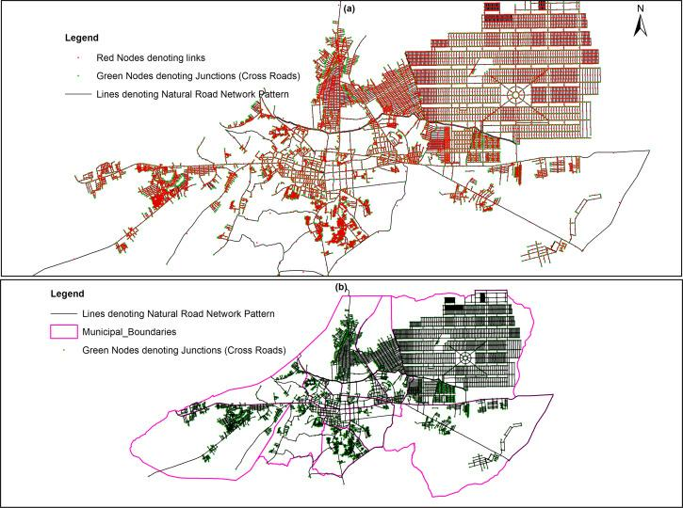
Graphs
Graphs can be used in various applications, such as computer networks, road maps, social networks, etc., to represent the connections between different entities.
The graph data structure is amenable to specific types of analysis such as clustering, community detection, shortest path, page rank.

Slide 19
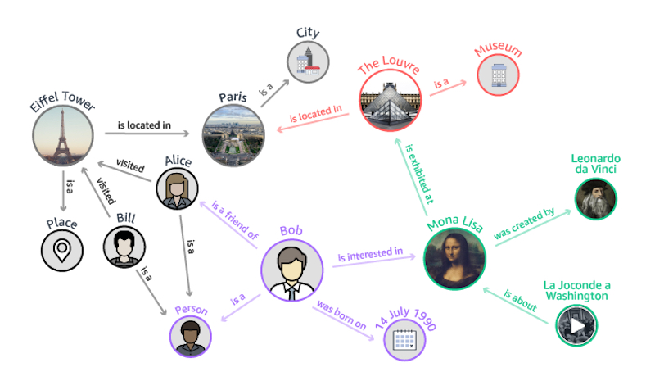
Knowledge Graphs
A knowledge graph is a type of graph designed specifically designed to capture the meaning (or semantics) of entities, their relationships and their attributes.
Unlike a basic graph, which could theoretically represent any kind of data in a network form, a knowledge graph is focused on semantic knowledge representation, enabling complex queries and reasoning about entities and their relationships.

Slide 20


Slide 21
Bob is an Entity
(aka Thing aka Individual)

Slide 22
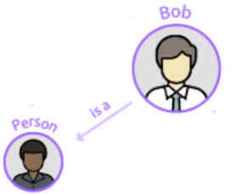
Bob is a Person
Person is a Type (aka class, category)
“is a” is a Relation (aka property, predicate)
Bob is an instance of the Type Person
Bob is an Individual

Slide 23
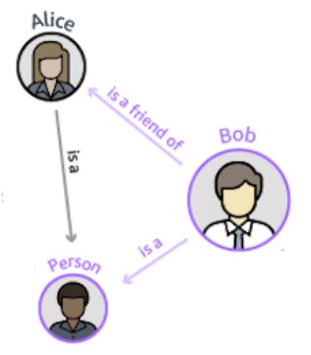
Alice is a Person
Alice is an Instance of Person
Bob is a friend of Alice
“is a friend of” is a Relation
the relation “is a friend of” holds between Bob and Alice

Slide 24
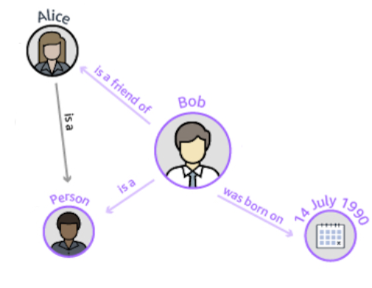
Bob was born on 14 July 1990
“was born on” is an Attribute (aka Property)
14 July 1990 is a Date
A Date is a Datatype

Slide 25
Individual
type
instance
entity
relation
attribute

Slide 26
A (widely agreed) definition for the term
knowledge graph is lacking.
“We define a knowledge graph as: a graph, composed of a set of assertions (edges labeled with relations) that are expressed between entities (vertices), where the meaning of the graph is encoded in its structure, the relations and entities are unambiguously identified, a limited set of relations are used to label the edges, and the graph encodes the provenance, especially justification and attribution, of the assertions.”
McCusker et al. (2018), What is a Knowledge Graph?

Slide 27
Individual
type
statement provenance:
when was the statement made?
who made the statement?
where were they when the statement was made?
how was it reported?
what are the terms of (re)use?
instance
entity
relation
attribute

Slide 28
Individual
type
context:
when (in which time interval) does the relation hold true?
is there a particular place in which this relation holds true?
are there other agents that must be present for it to hold true?
instance
entity
relation
attribute

Slide 29
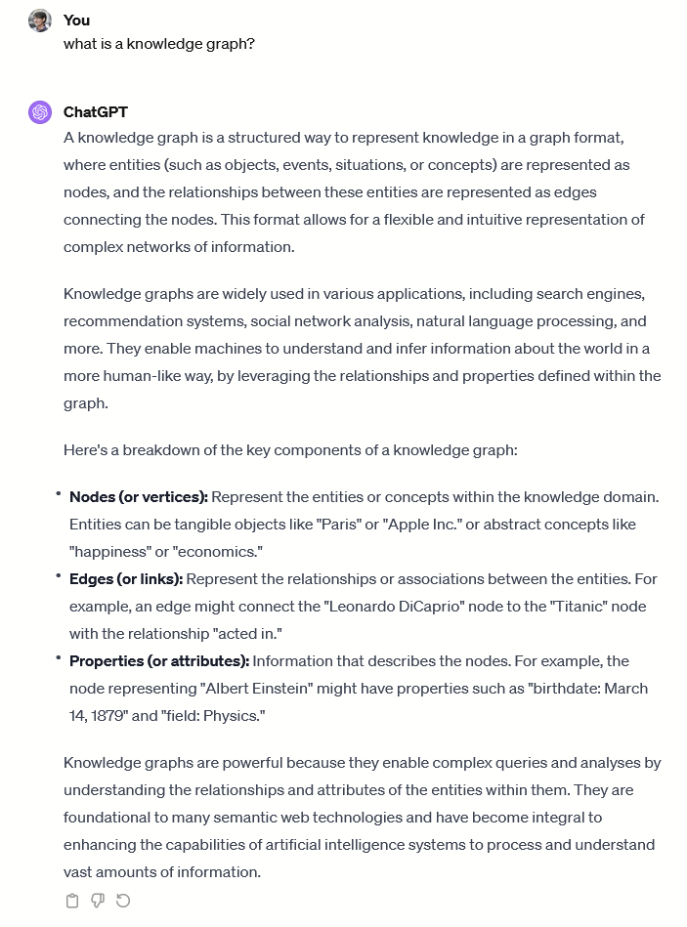

Slide 30
A Knowledge Graphs uses Ontologies to infer new facts
An ontology is a formal representation of knowledge amenable to automated reasoning. Ontology defines the kinds of things that exist and what relations may or may not hold between them.
The Ontology adds background knowledge to the KG: Very useful to infer new facts, and to check the quality (semantic coherence) of the KG.
Consider
KG Facts:
The Eiffel tower is-a Place
The Louvre is-a Museum
Paris is-a City
An Ontology could define:
Every Museum is a Place
Every City is a Place
In a logic that defines:
is-a as a transitive property, such that x is-a y, y is-a z, then x is-a z
Therefore, we can infer that
The Louvre is a Place
Paris is a Place

Slide 31

What primarily distinguishes a knowledge graph from a basic graph?
ⓘ
Click Present with Slido or install our Chrome extension to activate this poll while presenting.
Notes:
📣 This is Slido interaction slide, please don't delete it. ✅ Click on 'Present with Slido' and the poll will launch automatically when you get to this slide.

Slide 32
Why represent knowledge
as graphs?

Slide 33
Graphs as a KR paradigm
Accessible to humans and machines
Graph paradigm is intuitive for humans to understand
Graphs can be encoded with a formal semantics for machine inference
Facilitates integration of heterogeneous knowledge
Use of shared identifiers
Use of shared vocabularies
Creating links between entities from different datasets
Enables analysis
Decades of research on graph analysis & querying algorithms can be reused to explore, mine and analyse KGs

Slide 34
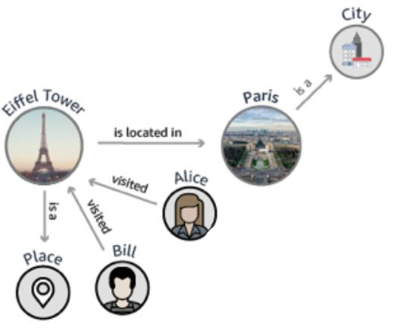
travel network

Slide 35
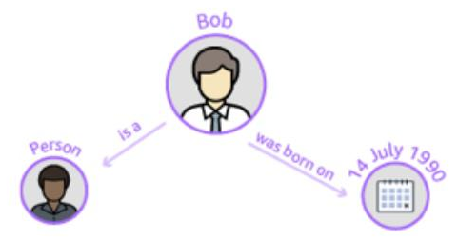
travel network
friend of
is a
is a
social network
linking relations

Slide 36
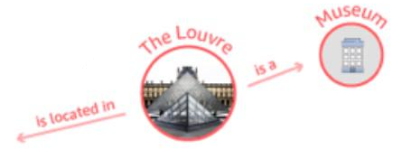
travel network
geo-objects
located in
friend of
is a
is a
social network
linking relations

Slide 37
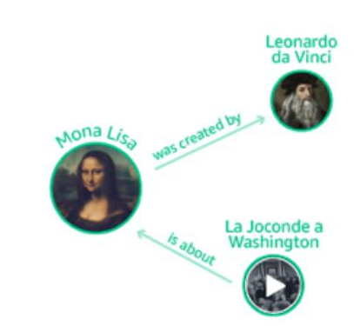
travel network
geo-objects
located in
exhibited in
friend of
art history
is a
interested in
is a
social network
linking relations

Slide 38
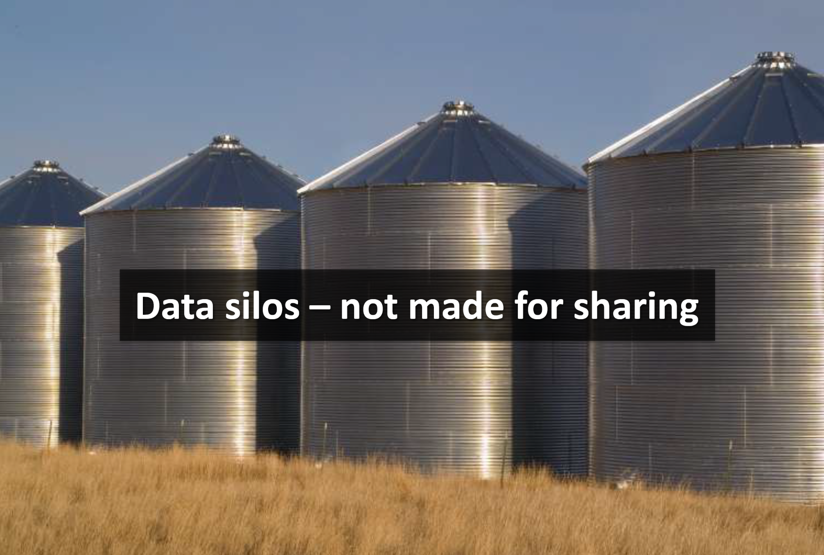

Slide 39
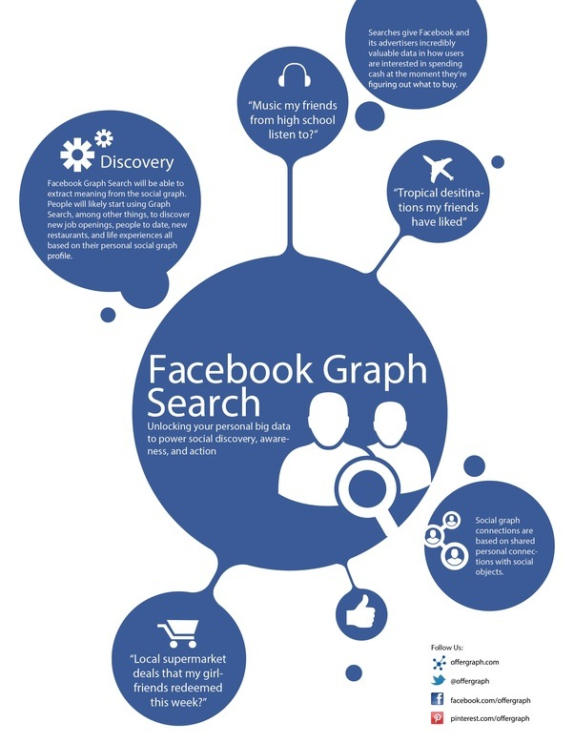
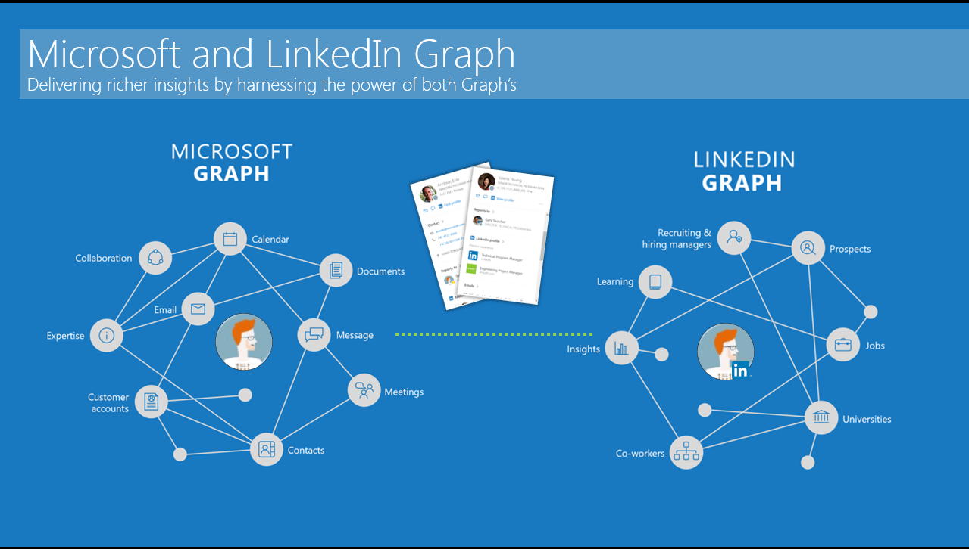

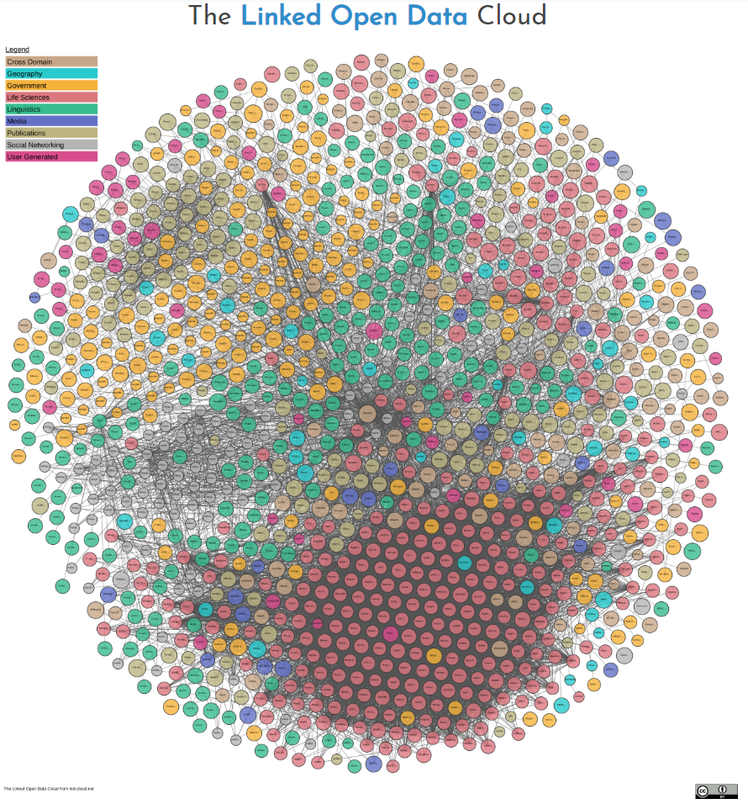







Slide 40
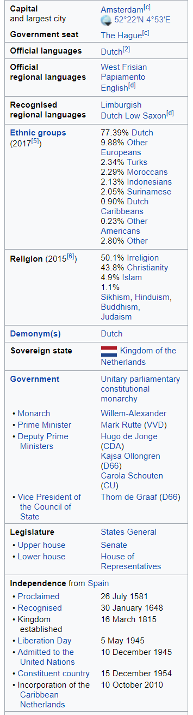
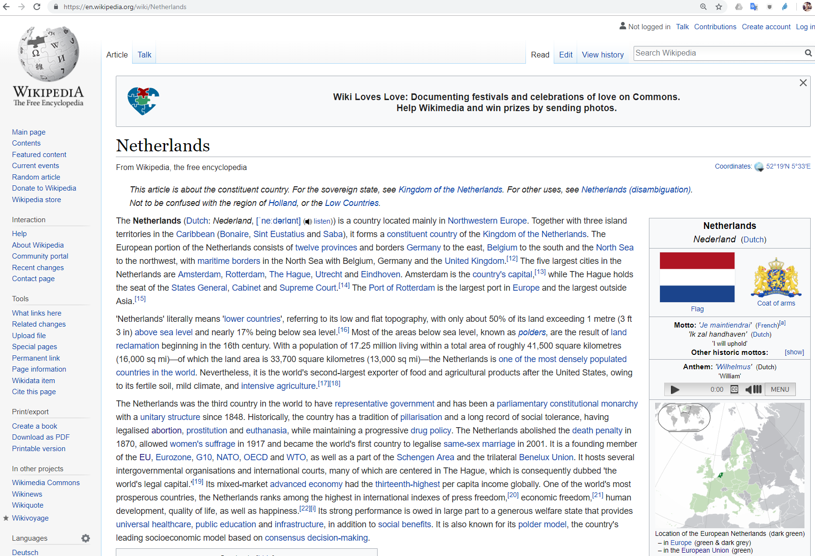

Slide 41
Crowdsourced community effort to extract structured content from information created in various Wikimedia projects
Structured information resembles an open knowledge graph which is available for everyone on the Web
English version of the DBpedia knowledge base describes
4.58 million things,
out of which 4.22 million are classified in a consistent ontology,
including 1,445,000 persons, 735,000 places , 241,000 organizations etc.
Localized versions of DBpedia in 125 languages
8.8 billion fact, large-scale-cross-domain knowledge graph

Slide 42
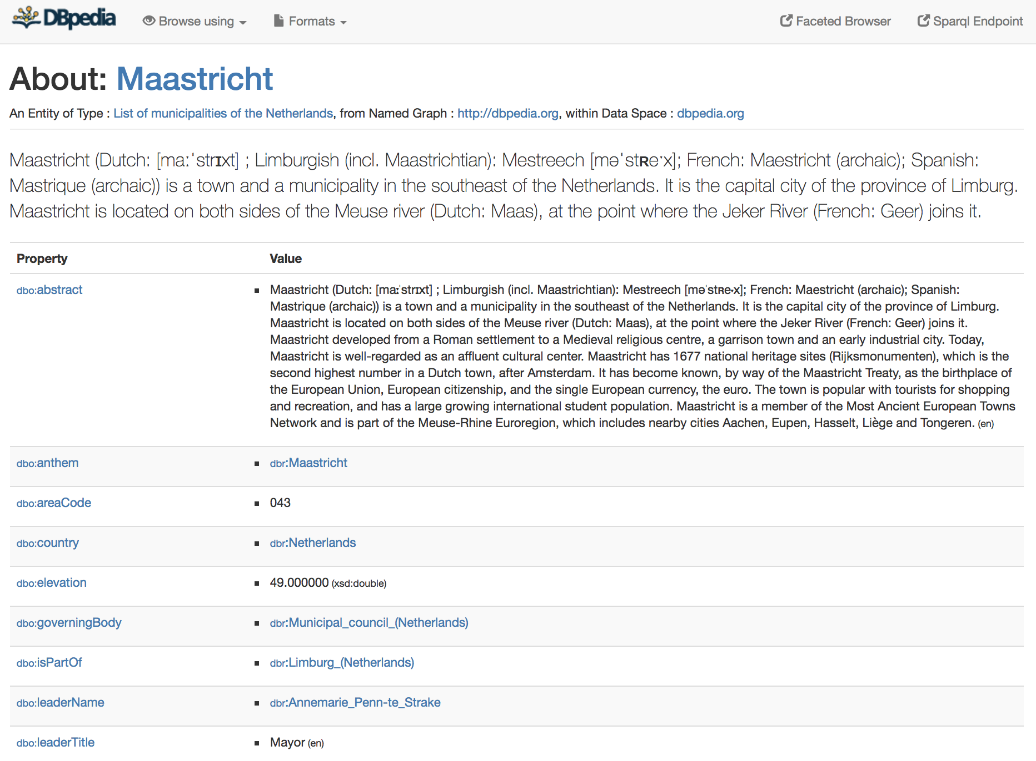
http://dbpedia.org/page/Maastricht
Notes:
Interlinked with other datasets

Slide 43
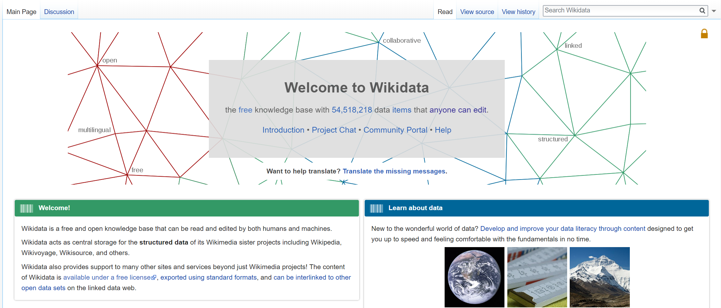
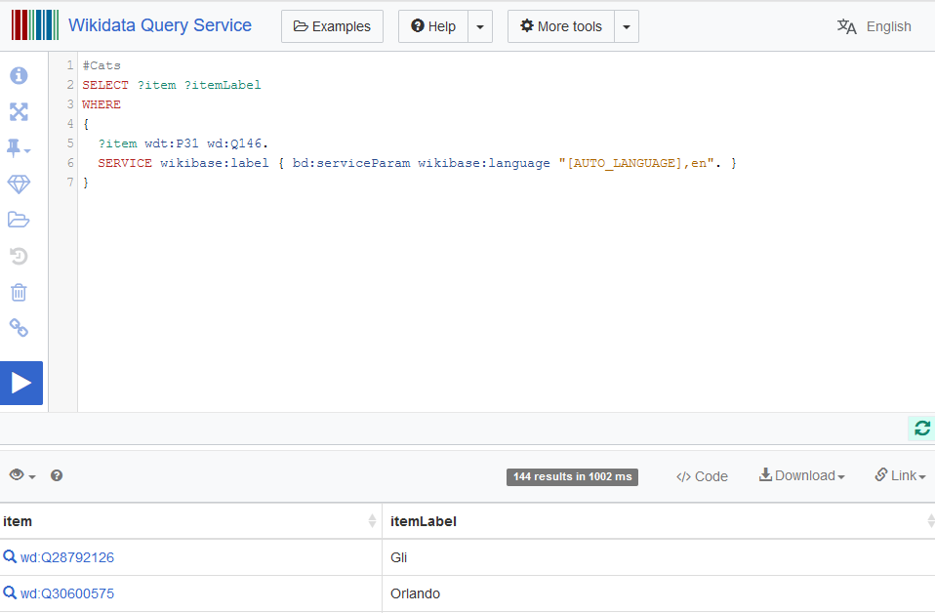
E.g. https://www.wikidata.org/wiki/Q1309

Slide 44
Graph Knowledge Representation

Slide 45
Long history of KR & graph representation
Existential Graphs (1896; Peirce)
Semantic Networks
Conceptual Graphs
Cognitive Semantic Networks
Structured Inheritance Networks
Multilayered Extended Semantic Networks (MultiNets)
Basic Conceptual Graphs
Full Conceptual Graphs
Hierarchical Semantic Form
Semantic Web Technologies
Property Graphs

Slide 46
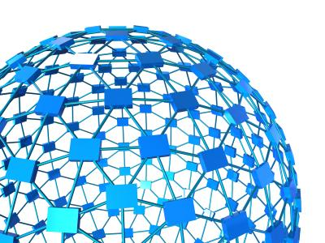

The Semantic Web
is a portal to the web of knowledge
standards for publishing, sharing and querying
facts, expert knowledge and services
scalable approach for the discovery
of independently constructed,
collaboratively described,
distributed knowledge
(in principle)

Slide 47
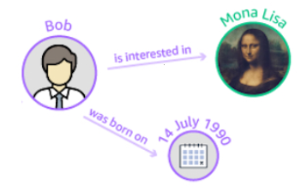
Resource Description Framework
Graph-based method for knowledge representation on the world wide web.
All things are named with Internationalized Resource Identifiers (IRIs)
Binary relations are directed, and expressed using a named property (annotations on the named property are shared in all graphs containing it).
Values of relations can be a IRI, blank node, or a Literal
http://rel.io/P1
https://en.wikipedia.org/wiki/Mona_Lisa
http://bob.info/me
http://relationsRus.org/wasBornOn
xml:DateTime

Slide 48

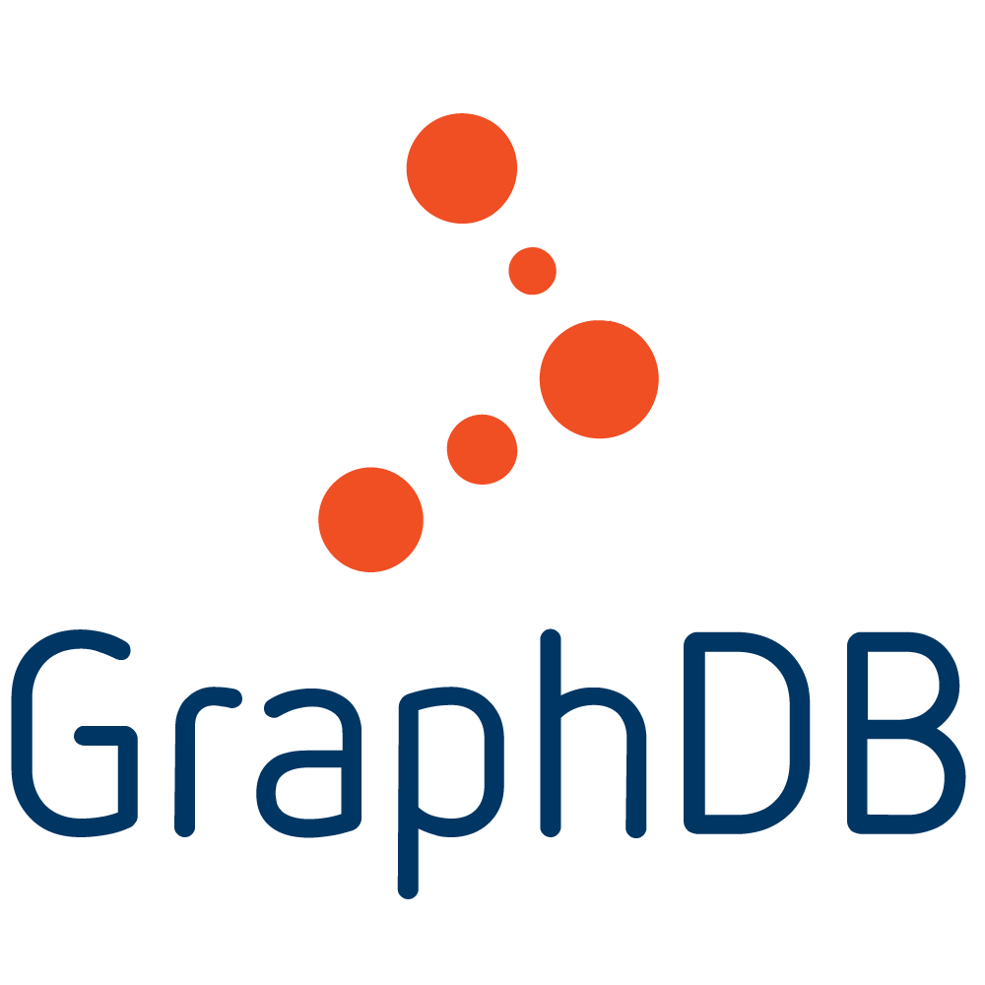



Semantic knowledge graphs
RDF store implementations
Formalism
Query language
See https://www.w3.org/wiki/LargeTripleStores

Slide 49
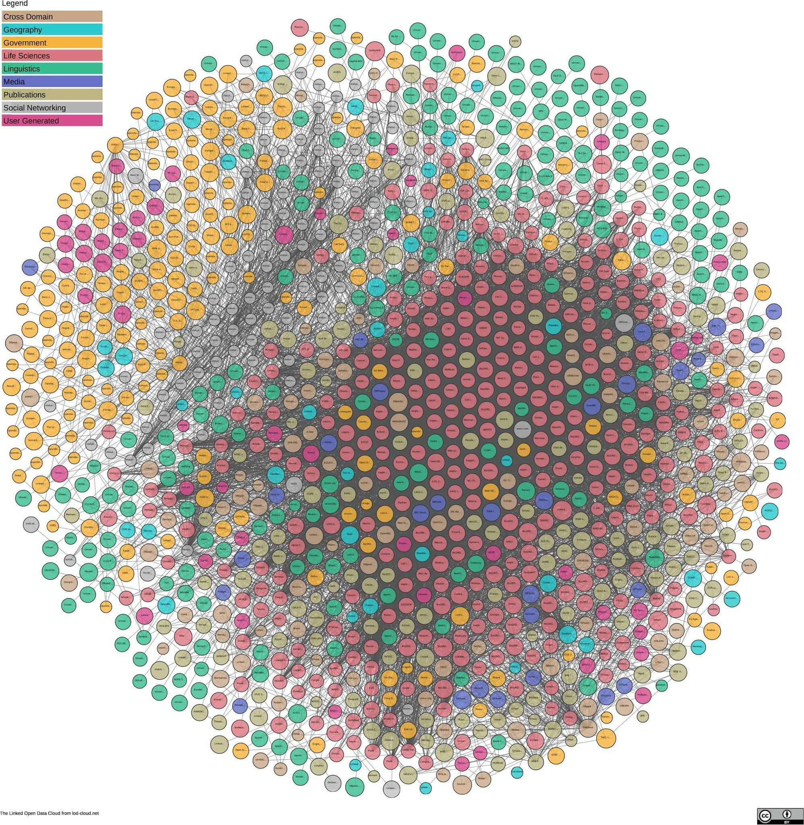
https://lod-cloud.net/
1,255 datasets
with 16,113 links
(as of end 2022)
Notes:
DBpedia is nucleus of LOD

Slide 50
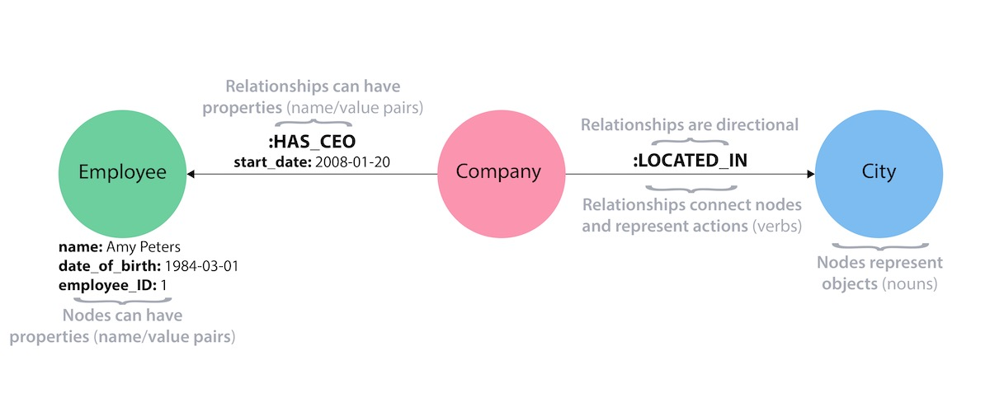
Property Graph
a property graph is an attributed, multi-relational graph. edges are labeled and both vertices and edges can have any number of key/value properties associated with them
Limitations: No explicit semantics for the graph, identifiers are not necessarily unique, no semantics for types and relations

Slide 51

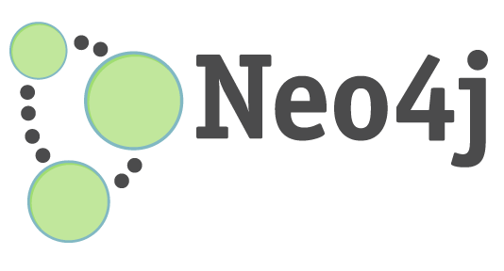
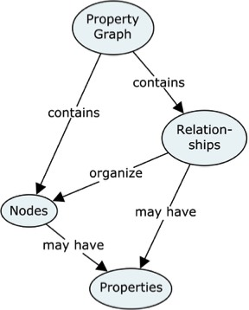


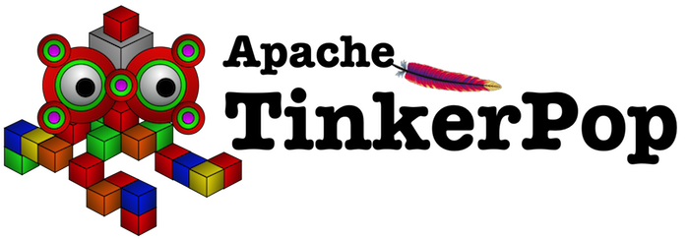
Property graphs
Graph database implementations
Formalism
Query languages
GraphQL
Cypher
Gremlin

Slide 52
Summary
Knowledge Graphs are very old and very new at the same time
Many definitions of knowledge graphs
Many representations for knowledge graphs
Many instances of knowledge graphs
Many ways to access knowledge graphs
You will learn how to build and mine specific representations and instances of knowledge graphs in a very short period of time!

Slide 53

What do you hope to learn in this course?
ⓘ
Click Present with Slido or install our Chrome extension to activate this poll while presenting.
Notes:
📣 This is Slido interaction slide, please don't delete it. ✅ Click on 'Present with Slido' and the poll will launch automatically when you get to this slide.

Slide 54
Questions?

